Slide 1
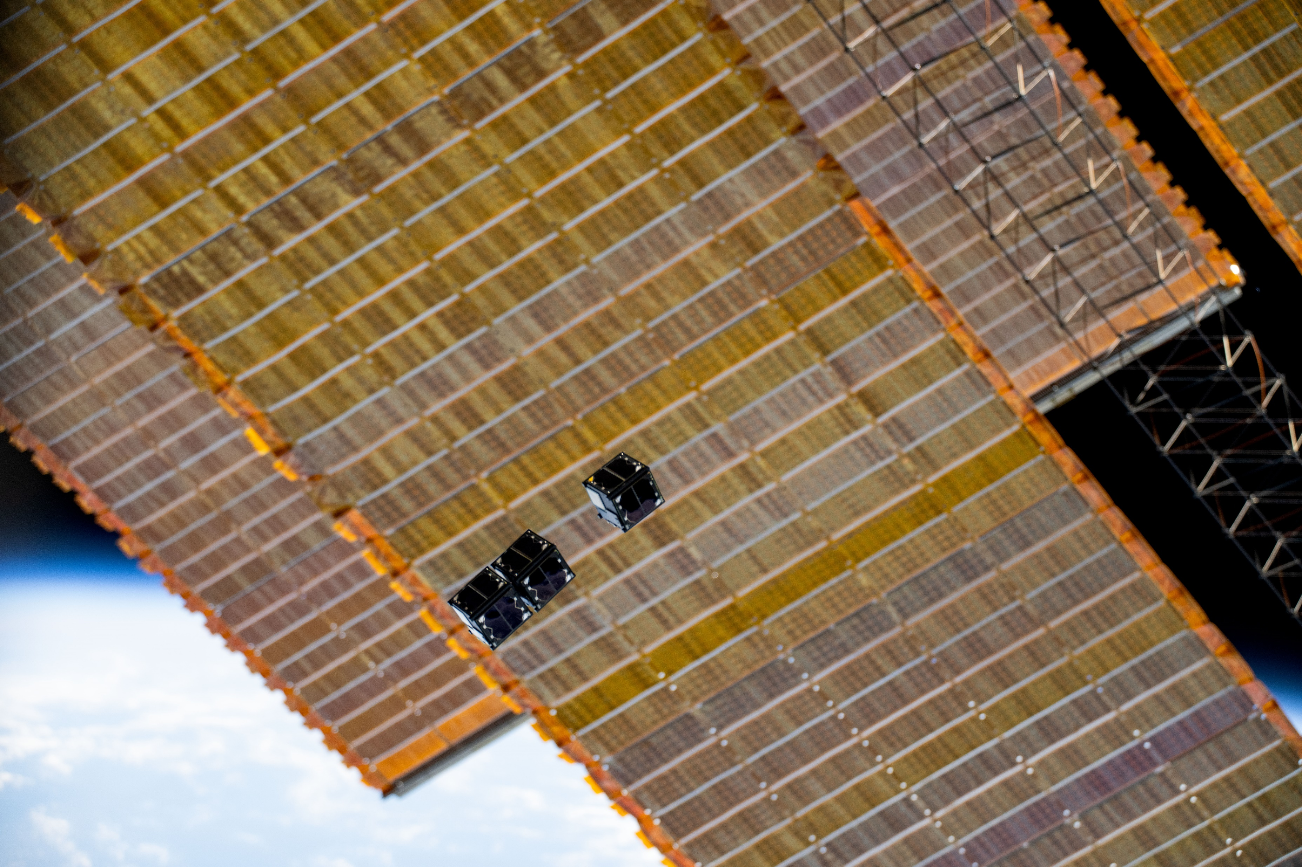




SCHOOL HOLIDAY
PROGRAM SUMMER 2025

Slide 2
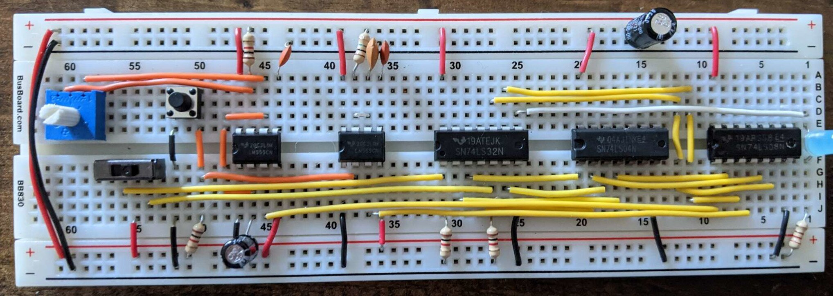
Introduction to BreadBoarding
Introduction to electronics prototyping
What is a Breadboard?
What tools are we going to use?
Applied Mathematics – Electronics
Voltage, Current and Resistance
What will our first electronic circuit be? How do we make it work?
How do we make an LED turn on?
Polarized Components
Calculating the correct Resistor
Wiring up the Breadboard
Extension Activities
Notes:
What is BinarX?
The BinarX Outreach Program is a high school outreach program that empowers WA students to design and build payloads for low-Earth orbit on board Binar CubeSats
We have grown from 3 groups (encompassing 5 schools) to 11 groups (encompassing 13 schools), but will cap participation at 8 schools or groups as we have more demand for the program than we can currently service.
We will also be running the school holiday program building payloads on Rob Howie’s custom PCBs and launching them in rockets that the students build and customise with 3D printed nose cones, which currently has 11 confirmed enrollments with students from 6 different schools or school groups across WA. 2 of these schools are not yet participating in the BinarX 2024 program so we expect the interest for participation to continue to grow.

Slide 3
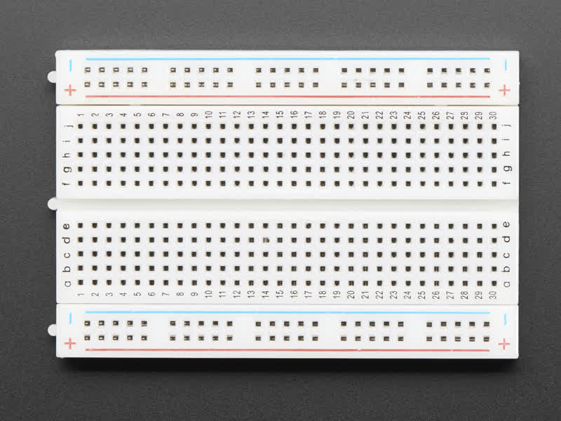
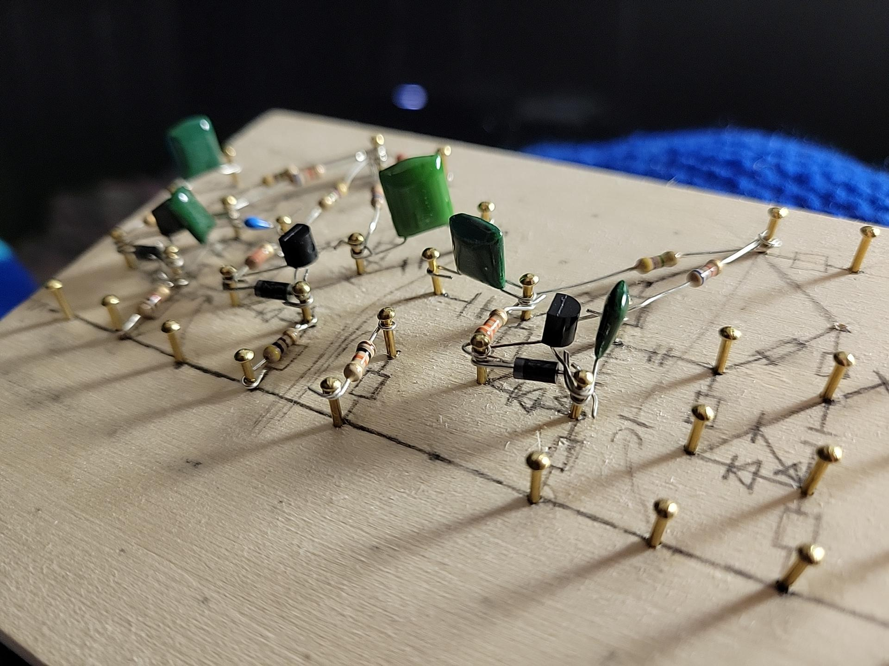
Introduction to electronics prototyping
Prototyping is a critical tool in the Engineering arsenal.
Simulations and mathematics equations cannot consider every variable within a real-world environment, therefore testing must be performed on systems to verify that their real world performance meets the criteria set for the system.
Breadboards are a way to test electronic circuits without permanently connecting components. They are a mostly accurate version of the real system.
The term breadboard comes from the original electronics prototyping method – nailing components to a slab of wood.
A Modern Breadboard
A Vintage Breadboard
Notes:
What is BinarX?
The BinarX Outreach Program is a high school outreach program that empowers WA students to design and build payloads for low-Earth orbit on board Binar CubeSats
We have grown from 3 groups (encompassing 5 schools) to 11 groups (encompassing 13 schools), but will cap participation at 8 schools or groups as we have more demand for the program than we can currently service.
We will also be running the school holiday program building payloads on Rob Howie’s custom PCBs and launching them in rockets that the students build and customise with 3D printed nose cones, which currently has 11 confirmed enrollments with students from 6 different schools or school groups across WA. 2 of these schools are not yet participating in the BinarX 2024 program so we expect the interest for participation to continue to grow.

Slide 4
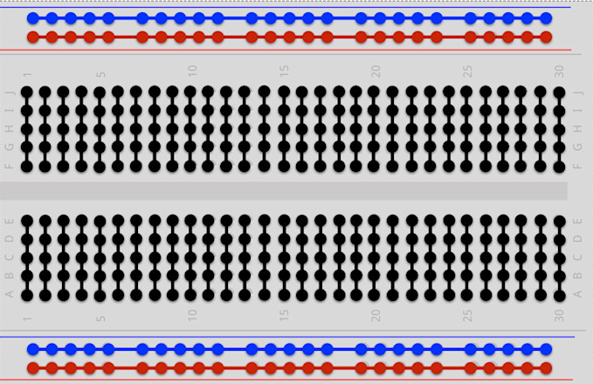
What is a breadboard?
Breadboards have several holes, underneath these holes are connected metal strips that conduct electricity between components.
In the example, you can see how the rows on the edge of the board are connected. The red line with the '+' symbol can be used for power, and the blue line with the '-' symbol can be used for ground.
The middle rows are connected vertically. You can spot numbers and letters marking each hole in a "battleship" style grid. The numbered columns are separate connections, and the lettered rows are connected into two strips consisting of the rows "A, B, C, D, E" and "F, G, H, I, J".
Components are poked into the holes to make circuit connections.
Notes:
What is BinarX?
The BinarX Outreach Program is a high school outreach program that empowers WA students to design and build payloads for low-Earth orbit on board Binar CubeSats
We have grown from 3 groups (encompassing 5 schools) to 11 groups (encompassing 13 schools), but will cap participation at 8 schools or groups as we have more demand for the program than we can currently service.
We will also be running the school holiday program building payloads on Rob Howie’s custom PCBs and launching them in rockets that the students build and customise with 3D printed nose cones, which currently has 11 confirmed enrollments with students from 6 different schools or school groups across WA. 2 of these schools are not yet participating in the BinarX 2024 program so we expect the interest for participation to continue to grow.

Slide 5
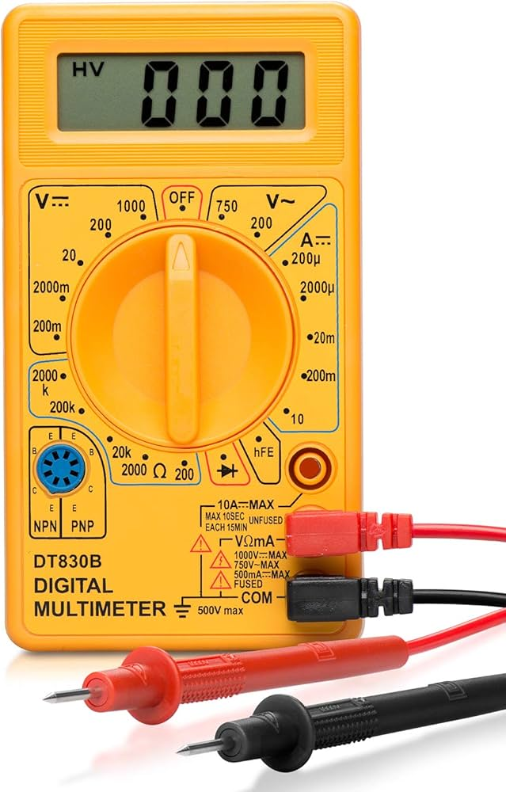
What tools are we going to use?
The tools required for electronics prototyping are very simple.
The most important tool is the Multimeter. This instrument allows you to measure almost every parameter of a circuit and is the most important tool you can have in electronics, after a pencil.
You will also need a breadboard and a selection of components to experiment with.
Notes:
What is BinarX?
The BinarX Outreach Program is a high school outreach program that empowers WA students to design and build payloads for low-Earth orbit on board Binar CubeSats
We have grown from 3 groups (encompassing 5 schools) to 11 groups (encompassing 13 schools), but will cap participation at 8 schools or groups as we have more demand for the program than we can currently service.
We will also be running the school holiday program building payloads on Rob Howie’s custom PCBs and launching them in rockets that the students build and customise with 3D printed nose cones, which currently has 11 confirmed enrollments with students from 6 different schools or school groups across WA. 2 of these schools are not yet participating in the BinarX 2024 program so we expect the interest for participation to continue to grow.

Slide 6
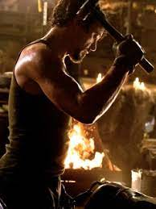

Applied mathematics - electronics
A hammer is not a traditional electronic engineering tool, however it can be useful if one has a particularly stubborn breadboard.
Unfortunately, electronics is not really like "Tony Stark in a cave with scraps" - it involves a bit more mathematics.
We will be using the most fundamental equation in electronics – Ohm's Law.
Ohm's Law: V = I * R
This law defines the relationship between Voltage, Current and Resistance in a circuit.
What electronic engineering is actually like.
Notes:
What is BinarX?
The BinarX Outreach Program is a high school outreach program that empowers WA students to design and build payloads for low-Earth orbit on board Binar CubeSats
We have grown from 3 groups (encompassing 5 schools) to 11 groups (encompassing 13 schools), but will cap participation at 8 schools or groups as we have more demand for the program than we can currently service.
We will also be running the school holiday program building payloads on Rob Howie’s custom PCBs and launching them in rockets that the students build and customise with 3D printed nose cones, which currently has 11 confirmed enrollments with students from 6 different schools or school groups across WA. 2 of these schools are not yet participating in the BinarX 2024 program so we expect the interest for participation to continue to grow.

Slide 7
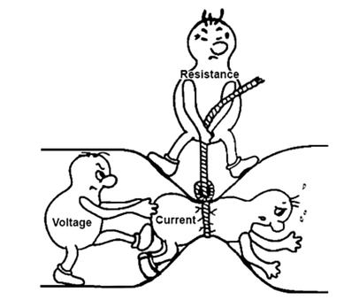
Voltage, Current and Resistance
What is Voltage, Current and Resistance?
Voltage: The potential for electricity to do something.
Current: The force that can be used to do something.
Resistance: The opposition to the force of doing something.
I prefer the water hose analogy: Voltage is the pressure of the water in the hose, current is the flow of water coming out of the hose and resistance is how thin the hose is.
Notes:
What is BinarX?
The BinarX Outreach Program is a high school outreach program that empowers WA students to design and build payloads for low-Earth orbit on board Binar CubeSats
We have grown from 3 groups (encompassing 5 schools) to 11 groups (encompassing 13 schools), but will cap participation at 8 schools or groups as we have more demand for the program than we can currently service.
We will also be running the school holiday program building payloads on Rob Howie’s custom PCBs and launching them in rockets that the students build and customise with 3D printed nose cones, which currently has 11 confirmed enrollments with students from 6 different schools or school groups across WA. 2 of these schools are not yet participating in the BinarX 2024 program so we expect the interest for participation to continue to grow.

Slide 8
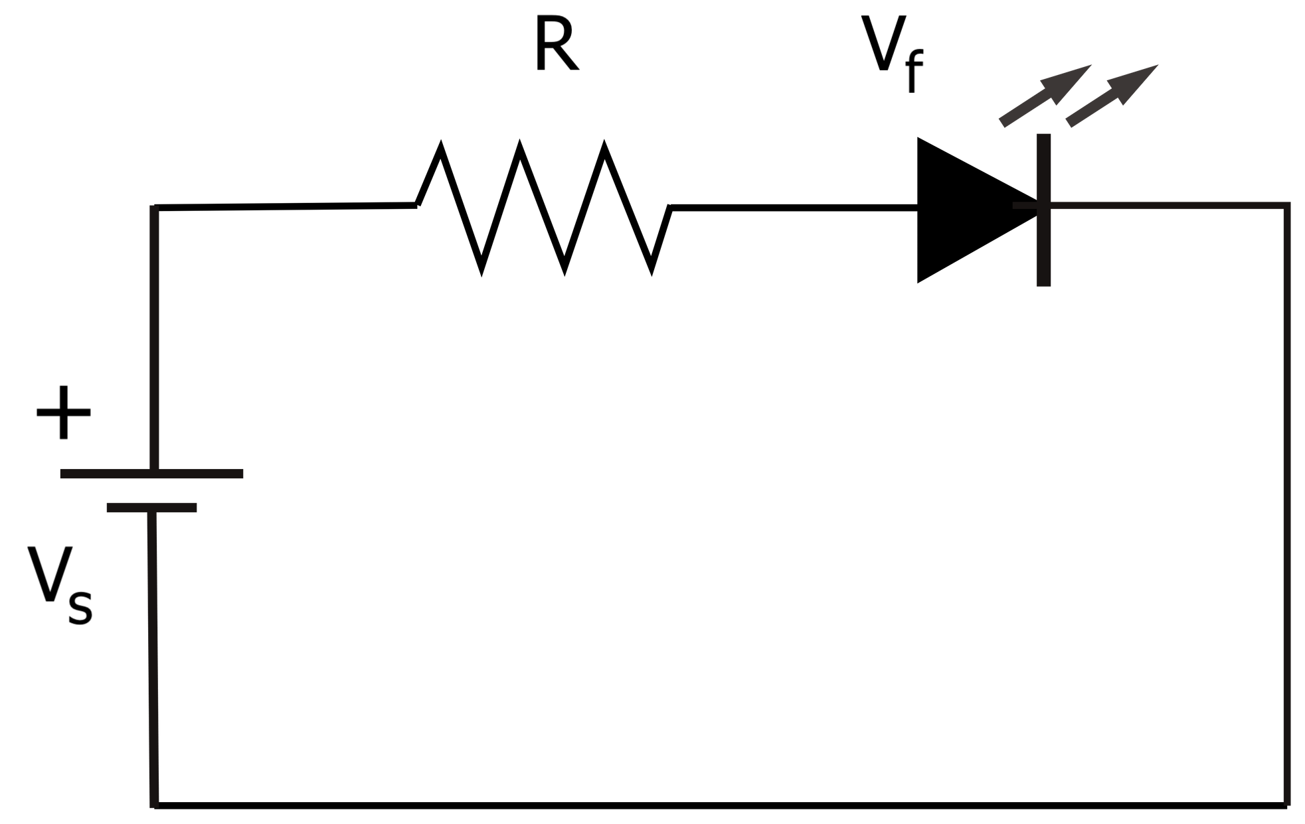
What will our first circuit be?
Our first circuit is going to be very simple. We will connect a battery to an LED and get it to turn on. In the process we will calculate the required component parameters to ensure the LED functions without wasting electricity by getting hot, and that it lights up with enough brightness.
Planning the circuit is like solving a puzzle. We have some of the pieces and we need to use those to calculate the rest.
Most components need a certain voltage to do something, and consume a certain current to do it. Resistance can be manipulated to vary the voltage and current at each circuit "node".
Notes:
What is BinarX?
The BinarX Outreach Program is a high school outreach program that empowers WA students to design and build payloads for low-Earth orbit on board Binar CubeSats
We have grown from 3 groups (encompassing 5 schools) to 11 groups (encompassing 13 schools), but will cap participation at 8 schools or groups as we have more demand for the program than we can currently service.
We will also be running the school holiday program building payloads on Rob Howie’s custom PCBs and launching them in rockets that the students build and customise with 3D printed nose cones, which currently has 11 confirmed enrollments with students from 6 different schools or school groups across WA. 2 of these schools are not yet participating in the BinarX 2024 program so we expect the interest for participation to continue to grow.

Slide 9
Circuit node?
Circuit nodes are a way of breaking down the analysis of a circuit into manageable equations.
We can calculate the circuit parameters at each connection between components to determine how each will respond and how they affect the overall circuit.
Taking the LED circuit – I have marked the three circuit nodes as A, B and C. You can see how these are the connections between each component.
As the components are connected in a line, this is known as a "series connected circuit".
Each node has a certain voltage, and has a certain amount of current passing through it.
A
B
C
Notes:
What is BinarX?
The BinarX Outreach Program is a high school outreach program that empowers WA students to design and build payloads for low-Earth orbit on board Binar CubeSats
We have grown from 3 groups (encompassing 5 schools) to 11 groups (encompassing 13 schools), but will cap participation at 8 schools or groups as we have more demand for the program than we can currently service.
We will also be running the school holiday program building payloads on Rob Howie’s custom PCBs and launching them in rockets that the students build and customise with 3D printed nose cones, which currently has 11 confirmed enrollments with students from 6 different schools or school groups across WA. 2 of these schools are not yet participating in the BinarX 2024 program so we expect the interest for participation to continue to grow.

Slide 10
Circuit Symbols
We can see three symbols in the circuit diagram on the right.
Clockwise from the left, the first symbol is that of a battery. You can see the small line indicating the "-" terminal and the larger line indicating the "+" terminal.
The next component is a squiggly line representing a resistor.
Finally, the LED is represented as an arrow with a line.
As the LED is polarized, the symbol indicates current flowing in the direction of the arrow, and being blocked by the bar in the other direction. The bar is known as the Cathode, and the arrow side the Anode. The Anode is positive, and will be the longer leg of the component.
A
B
C
Notes:
What is BinarX?
The BinarX Outreach Program is a high school outreach program that empowers WA students to design and build payloads for low-Earth orbit on board Binar CubeSats
We have grown from 3 groups (encompassing 5 schools) to 11 groups (encompassing 13 schools), but will cap participation at 8 schools or groups as we have more demand for the program than we can currently service.
We will also be running the school holiday program building payloads on Rob Howie’s custom PCBs and launching them in rockets that the students build and customise with 3D printed nose cones, which currently has 11 confirmed enrollments with students from 6 different schools or school groups across WA. 2 of these schools are not yet participating in the BinarX 2024 program so we expect the interest for participation to continue to grow.

Slide 11
Determine the forward voltage of your LED
Everyone pick an LED!
An LED converts electrical current into light. It requires a voltage to turn on, known as the forward voltage drop. The current converted determines the brightness of the LED. A common value for LED current is 10 milliamperes – 0.01 amps.
Set your multimeter to the mode marked with a small diode symbol. Connect the red lead to the Anode and the black lead to the Cathode.
The multimeter will display the forward voltage of the LED. This is the voltage drop across the LED when it is operating, and the required voltage to turn on. Write down this number.
A
B
C
Notes:
What is BinarX?
The BinarX Outreach Program is a high school outreach program that empowers WA students to design and build payloads for low-Earth orbit on board Binar CubeSats
We have grown from 3 groups (encompassing 5 schools) to 11 groups (encompassing 13 schools), but will cap participation at 8 schools or groups as we have more demand for the program than we can currently service.
We will also be running the school holiday program building payloads on Rob Howie’s custom PCBs and launching them in rockets that the students build and customise with 3D printed nose cones, which currently has 11 confirmed enrollments with students from 6 different schools or school groups across WA. 2 of these schools are not yet participating in the BinarX 2024 program so we expect the interest for participation to continue to grow.

Slide 12
Determine the voltage of the battery
A
B
C
Next, switch the multimeter to voltage mode. Connect the red lead to the positive of the battery and the black lead to the negative. The multimeter will display the voltage stored in the battery. Write this down.
Notes:
What is BinarX?
The BinarX Outreach Program is a high school outreach program that empowers WA students to design and build payloads for low-Earth orbit on board Binar CubeSats
We have grown from 3 groups (encompassing 5 schools) to 11 groups (encompassing 13 schools), but will cap participation at 8 schools or groups as we have more demand for the program than we can currently service.
We will also be running the school holiday program building payloads on Rob Howie’s custom PCBs and launching them in rockets that the students build and customise with 3D printed nose cones, which currently has 11 confirmed enrollments with students from 6 different schools or school groups across WA. 2 of these schools are not yet participating in the BinarX 2024 program so we expect the interest for participation to continue to grow.

Slide 13
Determine the resistor value
We can use algebra to rearrange ohms law and calculate resistance from current and voltage.
Ohms Law: V = I * R
Therefore...
R = V/I
But which V? node A or node B?
As we are calculating the voltage drop of the resistor, V is the difference between A and B (the voltage dropped by the resistor).
Therefore, V = V_{A} - V_{B}
A
B
C
Notes:
What is BinarX?
The BinarX Outreach Program is a high school outreach program that empowers WA students to design and build payloads for low-Earth orbit on board Binar CubeSats
We have grown from 3 groups (encompassing 5 schools) to 11 groups (encompassing 13 schools), but will cap participation at 8 schools or groups as we have more demand for the program than we can currently service.
We will also be running the school holiday program building payloads on Rob Howie’s custom PCBs and launching them in rockets that the students build and customise with 3D printed nose cones, which currently has 11 confirmed enrollments with students from 6 different schools or school groups across WA. 2 of these schools are not yet participating in the BinarX 2024 program so we expect the interest for participation to continue to grow.

Slide 14
Determine the resistor value
We know V_{A}, since this is connected directly to the output of the battery, it must be the same.
Therefore, V_{A} = V_{Battery}
We also know V_{B}, since the forward voltage of the LED is also the voltage drop. V_{C} is 0, as it is connected to the negative terminal of the battery.
Therefore, V_{F} = V_{B} – V_{C}
V_{F} = V_{B} – 0
V_{F} = V_{B}
A
B
C
Notes:
What is BinarX?
The BinarX Outreach Program is a high school outreach program that empowers WA students to design and build payloads for low-Earth orbit on board Binar CubeSats
We have grown from 3 groups (encompassing 5 schools) to 11 groups (encompassing 13 schools), but will cap participation at 8 schools or groups as we have more demand for the program than we can currently service.
We will also be running the school holiday program building payloads on Rob Howie’s custom PCBs and launching them in rockets that the students build and customise with 3D printed nose cones, which currently has 11 confirmed enrollments with students from 6 different schools or school groups across WA. 2 of these schools are not yet participating in the BinarX 2024 program so we expect the interest for participation to continue to grow.

Slide 15
Determine the resistor value
Inserting our values into the resistor equation:
R = V/I
R = (V_{A} – V_{B}) / I
But what is I?
Remember that this is a series connected circuit – components in series share voltage and have the same current. This is because there is only one path through all of the components for current to flow in the circuit.
Therefore, I = I_{LED} = 0.01 A
A
B
C
Notes:
What is BinarX?
The BinarX Outreach Program is a high school outreach program that empowers WA students to design and build payloads for low-Earth orbit on board Binar CubeSats
We have grown from 3 groups (encompassing 5 schools) to 11 groups (encompassing 13 schools), but will cap participation at 8 schools or groups as we have more demand for the program than we can currently service.
We will also be running the school holiday program building payloads on Rob Howie’s custom PCBs and launching them in rockets that the students build and customise with 3D printed nose cones, which currently has 11 confirmed enrollments with students from 6 different schools or school groups across WA. 2 of these schools are not yet participating in the BinarX 2024 program so we expect the interest for participation to continue to grow.

Slide 16
Assemble the circuit
A
B
C
The circuit can be directly transposed from a schematic to a breadboard
The nodes, A, B and C, correspond to connections – they are the equivalent of the black columns in the breadboard diagram.
Connecting the leads together in this way will allow electricity to flow through the circuit.
Notes:
What is BinarX?
The BinarX Outreach Program is a high school outreach program that empowers WA students to design and build payloads for low-Earth orbit on board Binar CubeSats
We have grown from 3 groups (encompassing 5 schools) to 11 groups (encompassing 13 schools), but will cap participation at 8 schools or groups as we have more demand for the program than we can currently service.
We will also be running the school holiday program building payloads on Rob Howie’s custom PCBs and launching them in rockets that the students build and customise with 3D printed nose cones, which currently has 11 confirmed enrollments with students from 6 different schools or school groups across WA. 2 of these schools are not yet participating in the BinarX 2024 program so we expect the interest for participation to continue to grow.

Slide 17


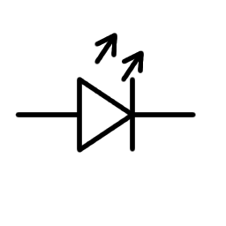







Assemble the circuit
Notes:
What is BinarX?
The BinarX Outreach Program is a high school outreach program that empowers WA students to design and build payloads for low-Earth orbit on board Binar CubeSats
We have grown from 3 groups (encompassing 5 schools) to 11 groups (encompassing 13 schools), but will cap participation at 8 schools or groups as we have more demand for the program than we can currently service.
We will also be running the school holiday program building payloads on Rob Howie’s custom PCBs and launching them in rockets that the students build and customise with 3D printed nose cones, which currently has 11 confirmed enrollments with students from 6 different schools or school groups across WA. 2 of these schools are not yet participating in the BinarX 2024 program so we expect the interest for participation to continue to grow.

